Slide 1
22C:19 Discrete Math Counting
Spring 2014
Sukumar Ghosh

Slide 2
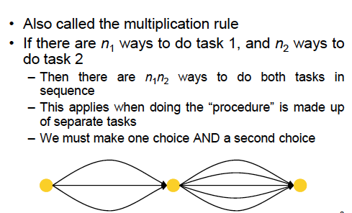
The Product Rule

Slide 3
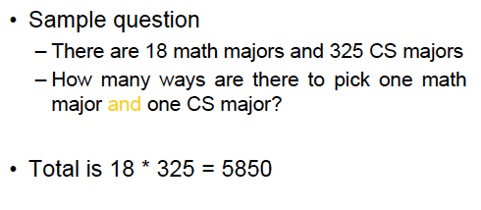
Example of Product Rule

Slide 4
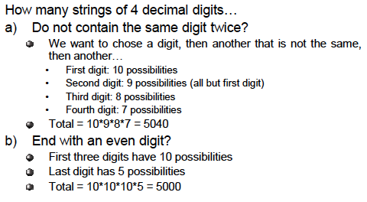
Example of Product Rule

Slide 5
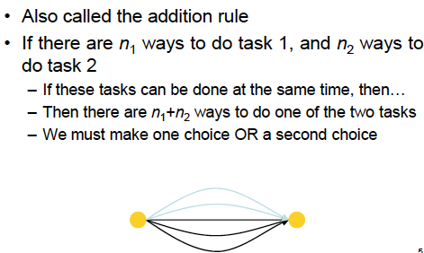
The Sum Rule

Slide 6
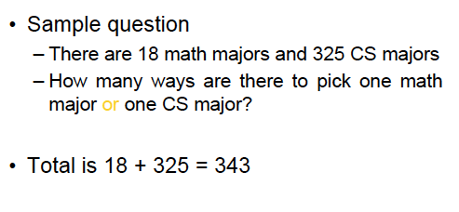
Example of Sum Rule

Slide 7
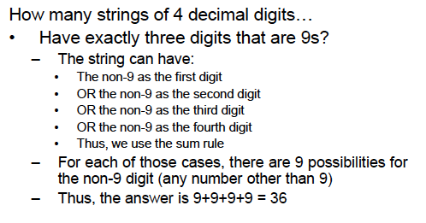
Example of Sum Rule

Slide 8
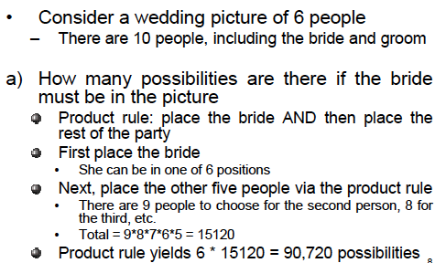
Wedding picture example

Slide 9
Counting subsets of a finite set
Let S be a finite set. Use product rule to show that the
number of different subsets of S is 2^{|S|}

Slide 10
Counting loops
How many times will the following program loop iterate
before the final solution is generated? What is the final
value of K?
K:=0
for i1: = 1 to n1
for i2 := 1 to n2
for i3:= 1 to n3
K:= K+1

Slide 11
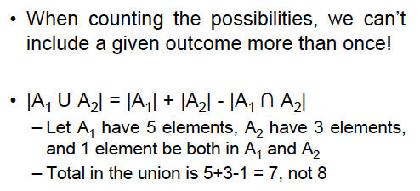
The Inclusion-Exclusion Principle

Slide 12
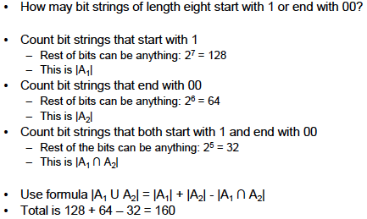
The Inclusion-Exclusion Principle

Slide 13
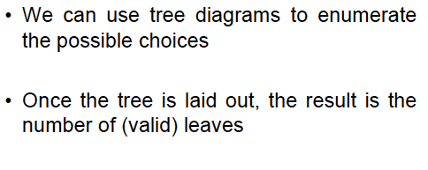
Tree diagrams

Slide 14
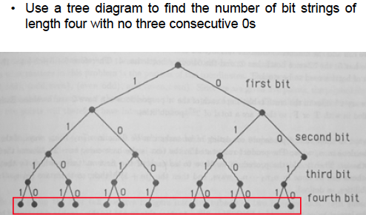
Tree diagrams

Slide 15
Pigeonhole Principle
If 20 pigeons fly into 19 pigeonholes, then at least one of
the pigeonholes must have two or more pigeons in it. Such
observations lead to the pigeonhole principle.
THE PIGEONHOLE PRINCIPLE. Let k be a positive integer. If
more than k objects are placed into k boxes, then at least
one box will contain two or more objects.

Slide 16
Application of Pigeonhole Principle
An exam is graded on a scale 0-100. How many students
should be there in the class so that at least two students
get the same score? (Do not consider scores with fractional points.)
Answer: More than 100.

Slide 17
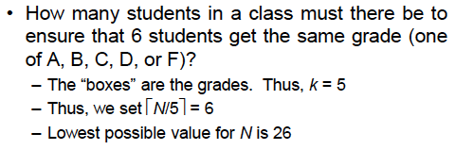
Generalized Pigeonhole Principle
If N objects are placed in k boxes, then there is at least
one box containing at least ꜒N/k˥objects.
Application 1.
In a class of 73 students, there are at least ꜒73/12˥=7 who are born in the same month.
Application 2.

Slide 18
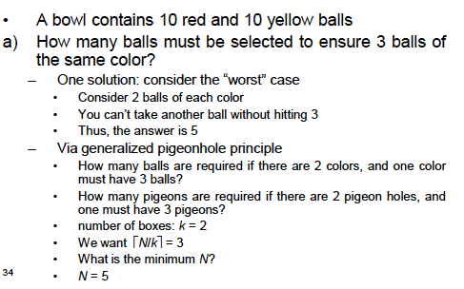
More applications of pigeonhole principle

Slide 19
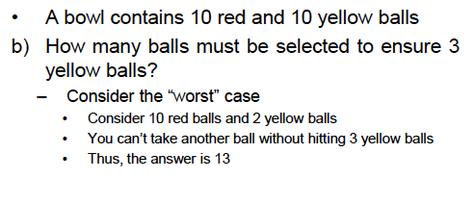
More applications of pigeonhole principle

Slide 20
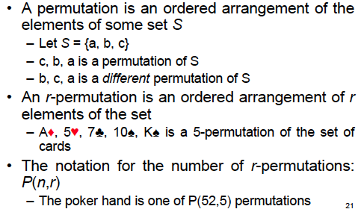
Permutation

Slide 21
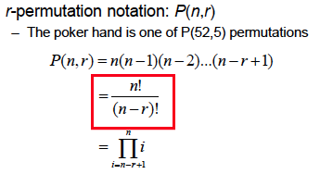
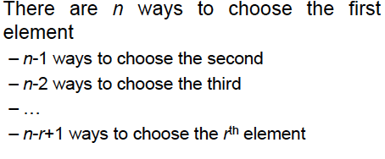
Permutation
Note that P (n,n) = n!

Slide 22
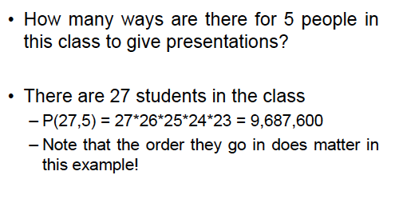
Example of permutation

Slide 23
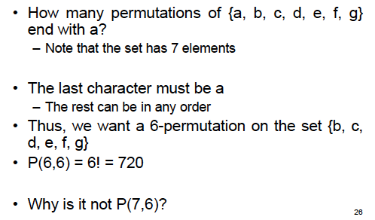
Exercise

Slide 24
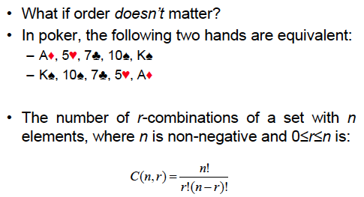
Combination
In permutation, order matters.

Slide 25

Example of combination
In how many bit strings of length 10, there are
exactly four 1’s?

Slide 26
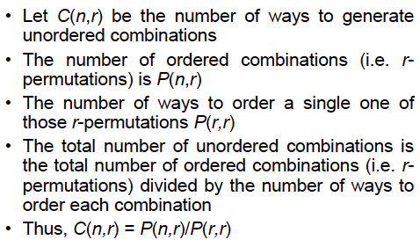
Proof of combination formula

Slide 27
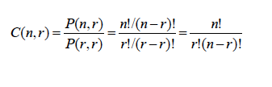
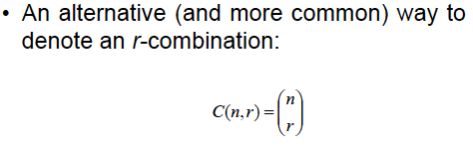
Proof of combination formula

Slide 28
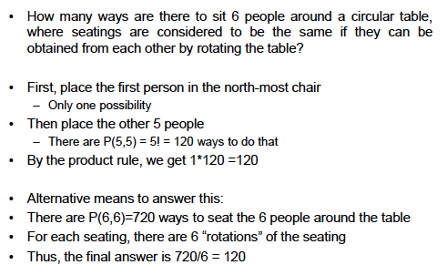
Circular seating

Slide 29
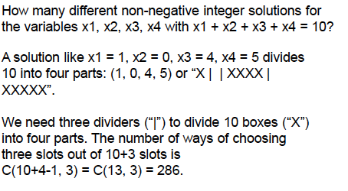
Other applications

Slide 30
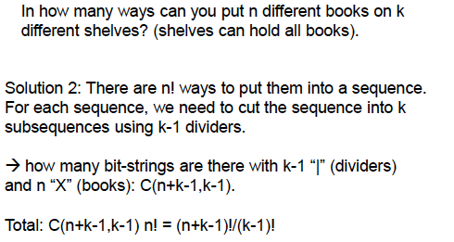
Book shelf problem

Slide 31
Pascal’s Identity
If n, k are positive integers and n ≥ k , then
C(n+1, k) = C(n, k) + C(n, k-1)

Slide 32
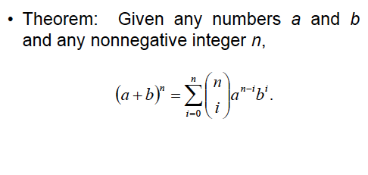
Binomial Theorem

Slide 33
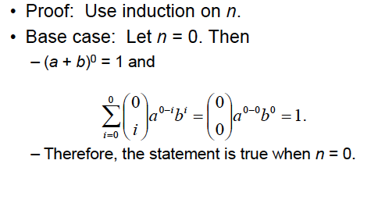
Proof of Binomial Theorem

Slide 34
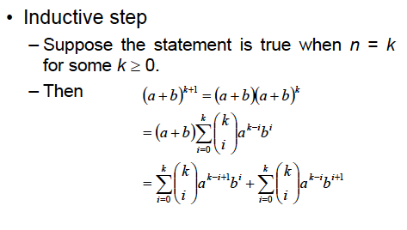
Proof of Binomial Theorem

Slide 35
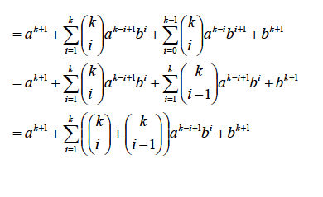
Proof of Binomial Theorem

Slide 36
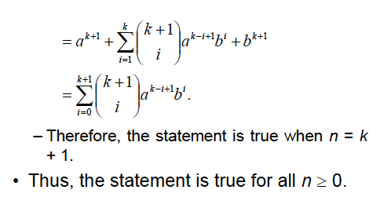
Proof of Binomial Theorem

Slide 37
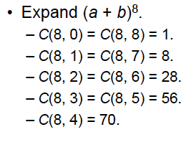
Example of Binomial Theorem

Slide 38
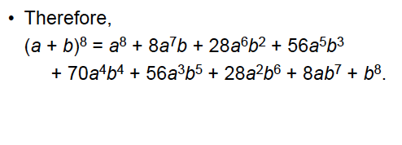
Example of Binomial Theorem

Slide 39
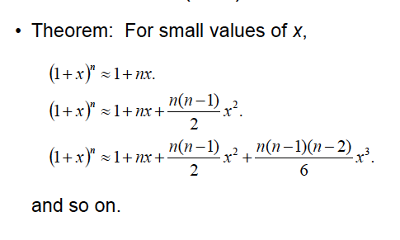
Example: Approximating (1+x)^{n}
The number of terms to be included will depend on the desired accuracy.

